Slide 1
CS F301: Principles of Programing Languages

Slide 2
Prolog: Types, Type Predicate, Expressions, Operators, Functions

Slide 3
PROLOG: INTRODUCTION
A Prolog program consists of a data base of facts and rules.
There is no structure imposed on a Prolog program, there is no main procedure, and there is no nesting of definitions.
All facts and rules are global in scope and the scope of a variable is the fact or rule in which it appears.
The readability of a Prolog program is left up to the programmer.
A Prolog program is executed by asking a question.
The question is called a query. Facts, rules, and queries are called clauses.
A query in Prolog is the action of asking the program about information contained within its data base.
Rules extend the capabilities of a logic program. They are what give Prolog the ability to pursue its decision-making process.

Slide 4
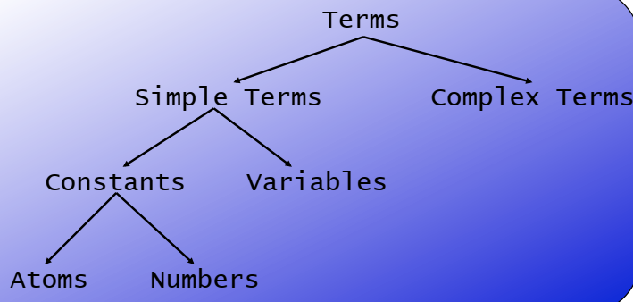
Terms (Types)
Prolog provides for numbers, atoms, lists and tuples.
Simple Terms
TYPE | VALUES
boolean | true, fail
integer | integers
real | floating point numbers
variable | variables
atom | character sequences

Slide 5
Terms (Types)
Complex terms
Atoms, numbers and variables are building blocks for complex terms.
A compound term has
a functor, which is an atom
one or more arguments, which can be any term
Syntax: functor first, then arguments in parentheses, separated by commas
Example
To create a term holding an (X,Y) position of (20,10)
position(20,10)
To create an employee data structure:
employee(1234, ’Jones’, ’James’, 100000)
hide(X,father(father(father(butch))))
The number of arguments a complex term has is called its arity.

Slide 6
Terms (Types)
List
A list is designated in Prolog by square brackets [ ].
List are ordered in Prolog.
Example: [dog,cat,mouse]
Records or tuples are represented as patterns.
The elements of a tuple are accessed by pattern matching.

Slide 7
Type predicates
Able to determine the type of a parameter.
PREDICATE | CHECKS IF
var(V) | V is a variable
nonvar(NV) | NV is not a variable
atom(A) | A is an atom
integer(I) | I is an integer
real(R) | R is a floating point number
number(N) | N is an integer or real
atomic(A) | A is an atom or a number
functor(T,F,A) | T is a term with functor F and arity A
T =..L | T is a term, L is a list.

Slide 8
Type predicates
functor(T,F,A) and T=..L are used to manipulate terms.
functor(T,F,A), T is a term, F is its functor, and A is its arity.
Example:
?- functor(t(a,b,c),F,A).
F = t
A = 3
yes
Here, t is the functor of the term t(a,b,c), and 3 is the arity (number of arguments) of the term.
=.. is used to compose and decompose terms.
Example:
?- t(a,b,c) =..L.
L = [t,a,b,c]
yes
?- T =..[t,a,b,c].
T = t(a,b,c)
yes

Slide 9
Expressions
Arithmetic expressions are evaluated with the built in predicate is which is used as an infix operator in the following form.
Syntax: variable is expression
Example:
?- X is 3*4.
X = 12
yes
plus(X, Y, Z) :- Z is X + Y.
?- plus(2,3,Z).
Z=5
SYMBOL | OPERATION
+ | addition
- | subtraction
* | multiplication
/ | real division
// | integer division
mod | modulus
** | power

Slide 10
Unification
Two terms unify,
if they are the same term, or
if they contain variables that can be uniformly instantiated with terms in such a way that the resulting terms are equal.
mia and mia unify 42 and 42 unify woman(mia) and woman(mia) unify
vincent and mia do not unify woman(mia) and woman(jody) do not unify
Definition
If T1 and T2 are constants, then T1 and T2 unify if they are the same atom, or the same number.
If T 1 is a variable and T2 is any type of term, then T1 and T2 unify, and T1 is instantiated to T2 (and vice versa).
If T1 and T2 are complex terms then they unify if: 1. They have the same functor and arity, and 2. all their corresponding arguments unify, and 3. the variable instantiations are compatible.

Slide 11
Unification
Examples with simple terms
?- mia = mia. yes
?- mia = vincent. no
?- mia = X. X=mia no
?- X=mia, X=vincent. no
Why? After working through the first goal, Prolog has instantiated X with mia, so that it cannot unify it with vincent anymore. Hence the second goal fails.

Slide 12
Unification
Example of Complex Terms
?- k(s(g),Y) = k(X,t(k)). X=s(g) Y=t(k) yes
?- k(s(g),t(k)) = k(X,t(Y)). X=s(g) Y=k yes
?- loves(X,X) = loves(marsellus,mia). no

Slide 13
Unification
Programming with Unification
vertical( line(point(X,Y), point(X,Z))). horizontal( line(point(X,Y), point(Z,Y))).
?- vertical(line(point(1,1),point(1,3))). yes ?- vertical(line(point(1,1),point(3,2))). no ?- horizontal(line(point(1,1),point(1,Y))).
Y = 1;
yes
?- horizontal(line(point(2,3),Point)). Point = point(_554,3); no

Slide 14
Boolean Predicates
SYMBOL OPERATION ACTION
A =:= B equal (value) evaluates A and B
to determine if equal
A =\+= B not equal (value)
A < B less than (numeric)
A =< B less or equal (numeric)
A > B greater than (numeric)
A >= B greater or equal (numeric)
A @< B less than (terms)
A @=< B less or equal (terms)
A @> B greater than (terms)

Slide 15
Boolean Predicates
Examples
3 @< 4
3 @< a
a @< abc6
natural_number(N) :- integer(N), N >= 0.
?- natural_number(3).
yes
?- natural_number(-2).
no
All are true
Note:
@< does nothing more than a string comparison
For example:
?- ab @< abc
yes
?- abcd @< ab
no
Value of functor with argument (term) is always more than any numeric and character (or string).
< is only for numeric.

Slide 16
Logical Operators
Predicates are functions which return a boolean value.
The logical operators are used in the definition of rules.
a :- b. % a if b
a :- b,c. % a if b and c.
a :- b;c. % a if b or c.
a :- not b. % a if b fails
a :- b -> c;d. % a if (if b then c else d)
SYMBOL | OPERATION
not | negation
, | logical conjunction
; | logical disjunction
:- | logical implication
-> | if-then-else

Slide 17
Functions
Prolog does not provide for a function type therefore, functions must be defined as relations. Both the arguments to the function and the result of the function must be parameters to the relation.
Relations are commonly defined using multiple rules
Factorial: the definition requires two rules, one for the base case and one for the inductive case. Example
fac(0,1).
fac(N,F) :- N > 0, M is N - 1,
fac(M,Fm), F is N * Fm.
?- fac(5,F).
120
The second rule states that if N > 0, M = N - 1,
Fm is (N-1)!, and F = N * Fm, then F is N!.
is: acts as an assignment operator

Slide 18
Functions
Prolog programming definition of the minimum.
minimum(M,N,M) :- M =< N.
minimum(M,N,N) :- N =< M.

Slide 19
Thank you

